Slide 1


CRYPTO TRACKER WEB APPLICATION

Slide 2



Team Members
CS 5A
AKANKSHA MISHRA 2000290120017
ANUSHRAYA SHARMA 2000290120037

Slide 3

CONTENTS
PROBLEM STATEMENT
SOLUTION
TECHNOLOGY USED
FLOWCHART
APPLICATION
FUTURE SCOPE

Slide 4

PROBLEM STATEMENT
Cryptocurrencies form a important aspect and part of our economy, and as it is a fairly new emerging domain, the information resources are widely scattered. This proves to be a major hurdle for potential and new investors as well who want to learn about this domain. Combining information from multiple resources - evaluating which ones to trust at the same time, and doing all this at regular intervals of time (considering the volatality of cryptos) increases the slope of the learning curve involved even more.

Slide 5

SOLUTION
Our web-app aims to solve this problem - designed to present all information in a structured and centralised manner. Ranging from history and analysis of past performance to reliable predictions about future dips and rises, this covers them all. Adding on top of these, handy tools like real time value, local currency conversions, monitor of top performing currencies, and other performance statistics are also integrated.

Slide 6

TECHNOLOGY USED
REACT JS
MATERIAL UI
CHART JS
CSS
JAVASCRIPT

Slide 7
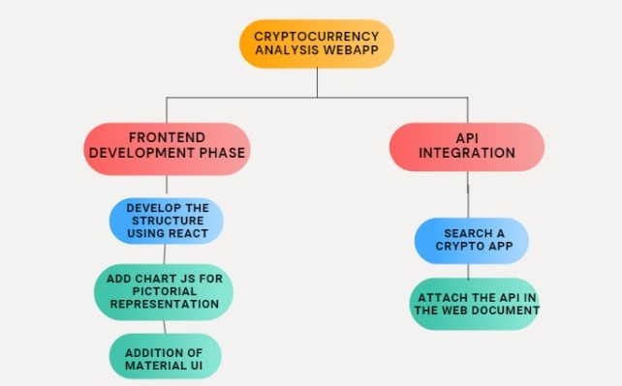
FLOWCHART

Slide 8
APPLICATION
Allows to track the total amount and value of cryptocurrencies across various wallets.
This web app let you track historic transactions, their worth, and destinations or sources.
This web app also give the actual live price of any cryptocurrencies .

Slide 9


FUTURE SCOPE
The crypto based web-app has a wide scope in the upcoming world as the awareness regarding the cryptocurrency investments is increasing day by day therefore people are more lean towards these cryptos and want to make better investments in these, this webapp can find applications in the stock markets and crypto transactions as well as can be used by various industries and tech giants to make profit and boost the growth of their company and the economy by making a fruitful and profitable investments.

Slide 10



